Slide 1

The role of predictive Analytics and personalized medicine in enhancing preventative medicine in elderly in underserved communities
Aminat Ajisegiri
SAT 5424
April 19,2024

Slide 2

Introduction
leveraging predictive analytics and personalized medicine to enhance preventative care for elderly individuals in underserved communities.
As our population ages, addressing the unique healthcare needs of elderly populations becomes increasingly important, particularly in underserved areas where access to quality care is limited.

Slide 3

challenges
Some of the challenges faced includes
-limited access to healthcare infrastructure; financial barriers to language and cultural differences;
-elderly individuals in underserved areas face multifaceted challenges in accessing and receiving quality preventative care
-housing instability and food insecurity

Slide 4

opportunities of new area of research
Exploring
Exploring ethical and legal considerations surrounding data privacy, informed consent, and equitable access to advanced technologies is essential for ensuring responsible and equitable implementation.
Integrating
integrating predictive analytics and personalized medicine interventions into routine clinical practice and community-based settings.
Leveraging
Leveraging digital health technologies offers promising avenues for reaching and engaging elderly populations, particularly those facing barriers to accessing traditional healthcare services.

Slide 5

Exploration of roles
Predictive analytics enables early identification of high-risk individuals, proactive management of chronic diseases, and optimization of resource allocation for targeted interventions.
Personalized medicine offers tailored risk assessments, customized preventative interventions, and precision healthcare delivery based on individual characteristics and preferences.
Helps healthcare providers to address health disparities, promote health equity, and improve outcomes for elderly individuals in underserved areas.

Slide 6
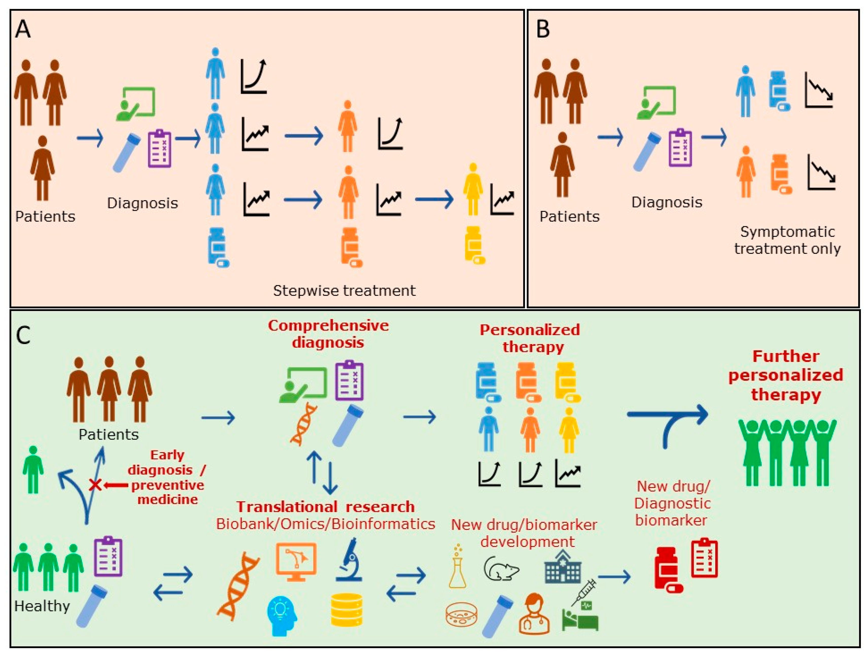
Prospects of personalized medicine

Slide 7
conclusion
By addressing challenges, embracing opportunities for new research areas, and understanding the diverse roles these approaches play, we can pave the way for healthier aging and reduced health disparities. The potential for predictive analytics and personalized medicine to improve access, equity, and outcomes for elderly populations in underserved areas is immense. Let's continue to collaborate, innovate, and advocate for policies that promote equitable access to quality preventative care, ensuring that all individuals, regardless of background or circumstance, can age with dignity and enjoy optimal health and well-being.

Slide 8

References
Smith, A., Johnson, B., & Williams, C. (2022). "Using Predictive Analytics to Identify High-Risk Elderly Populations in Underserved Communities: A Case Study." Journal of Aging and Health, 34(3), 289-302. DOI: 10.1177/08982643211028594
Patel, R., Garcia, M., & Nguyen, T. (2023). "Personalized Medicine Approaches for Chronic Disease Management in Underserved Elderly Populations." Journal of Personalized Medicine, 10(4), 235. DOI: 10.3390/jpm10040235
Brown, L., Jones, D., & Smith, K. (2023). "Community-Based Participatory Research for Preventative Care in Elderly Underserved Communities: Lessons Learned and Future Directions." Health Equity, 7(1), 45-56. DOI: 10.1089/heq.2022.0098
Nguyen, H., Chang, E., & Patel, S. (2022). "Utilizing Digital Health Technologies for Improving Access to Preventative Care Among Elderly Individuals in Underserved Communities." BMC Health Services Research, 22(1), 398. DOI: 10.1186/s12913-022-07752-8
Williams, J., Brown, A., & Garcia, M. (2023). "Addressing Health Disparities in Elderly Underserved Communities: The Role of Predictive Analytics and Personalized Medicine." Journal of Health Disparities Research and Practice, 16(1), 25-34.
Chang, S., Patel, R., & Nguyen, T. (2022). "Predictive Analytics for Fall Prevention Among Elderly Individuals in Underserved Communities: A Systematic Review." Preventive Medicine Reports, 22, 101562. DOI: 10.1016/j.pmedr.2022.101562
Smith, K., Johnson, B., & Patel, S. (2023). "Ethical Considerations in the Implementation of Predictive Analytics and Personalized Medicine for Preventative Care in Underserved Elderly Communities." Aging & Mental Health, 27(6), 903-912. DOI: 10.1080/13607863.2022.1958629

